Slide 1
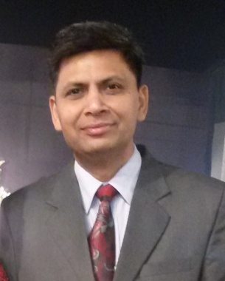
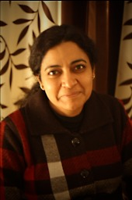
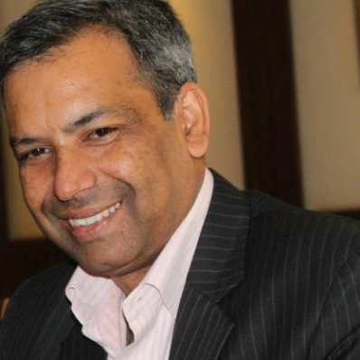
THE CORE TEAM-21 to 50 yrs in field
Sanjeev Sangal Principal Architect
Aradhana Sr. Architect
Shalabh Aran Project Management

